Slide 1


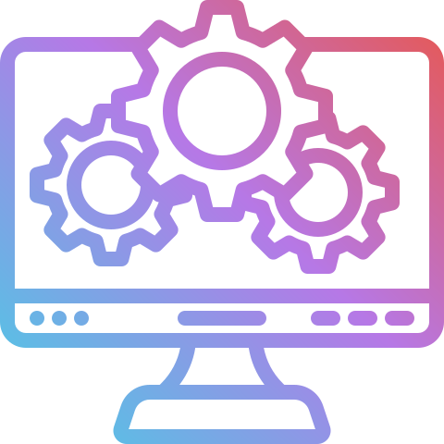
Topic : History of Operating Systems
Presented By,
Md. Imran Hosen
ID: IT-24060
Department of Information and Communication Technology, MBSTU
Supervised By,
Dr. Nazrul Islam sir

Slide 2
INTRODUCTION
•An OS manages hardware and software resources
•Acts as interface between user and hardware
•Core: memory, processes, files, hardware

Slide 3
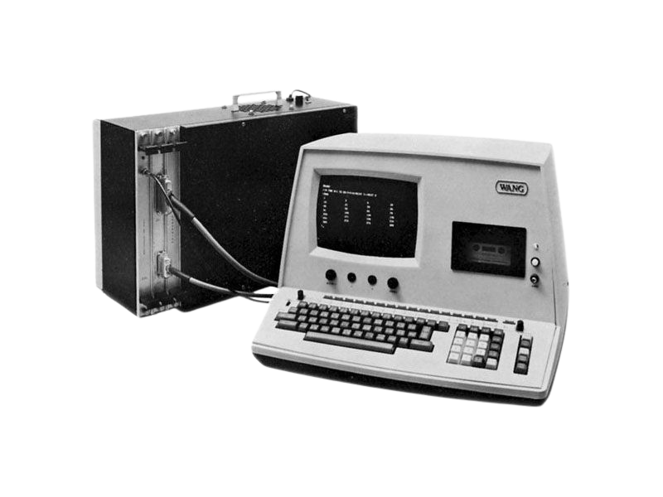
PRE-OS ERA (1940S)
•No operating systems
•Vacuum tubes hardware
•Manual setup via switches
•Low efficiency, one task only

Slide 4
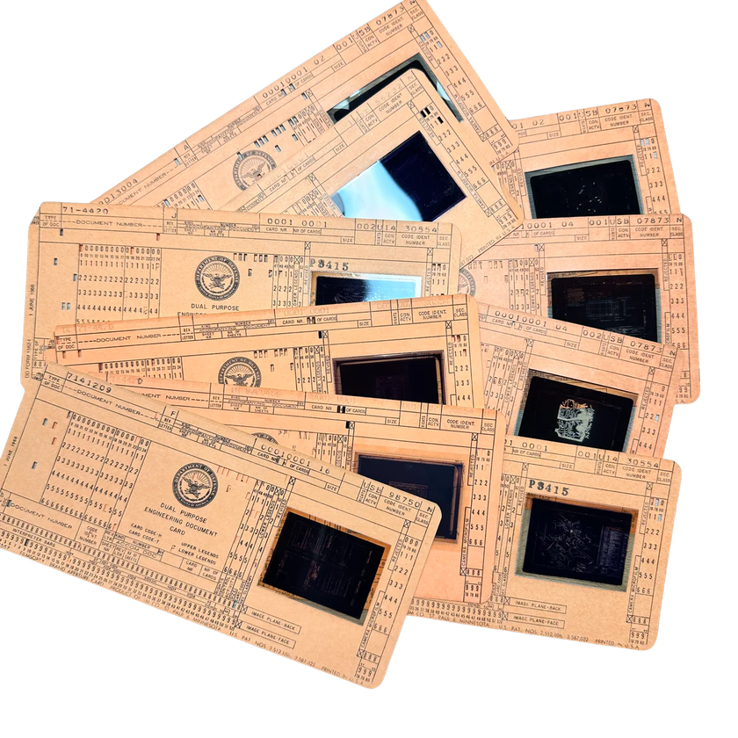
FIRST GENERATION (1950S)
•Batch processing introduced
•Punch cards used
•Reduced CPU idle time
•GM-NAA I/O (1956) first OS

Slide 5
SECOND GENERATION (LATE 1960S)
•Multics project
•Joint MIT, Bell Labs, GE
•Complex but innovative
•Introduced file systems

Slide 6
UNIX REVOLUTION (1970S)
•Created at Bell Labs
•Simple, modular design
•Written in C language
•Portable OS

Slide 7
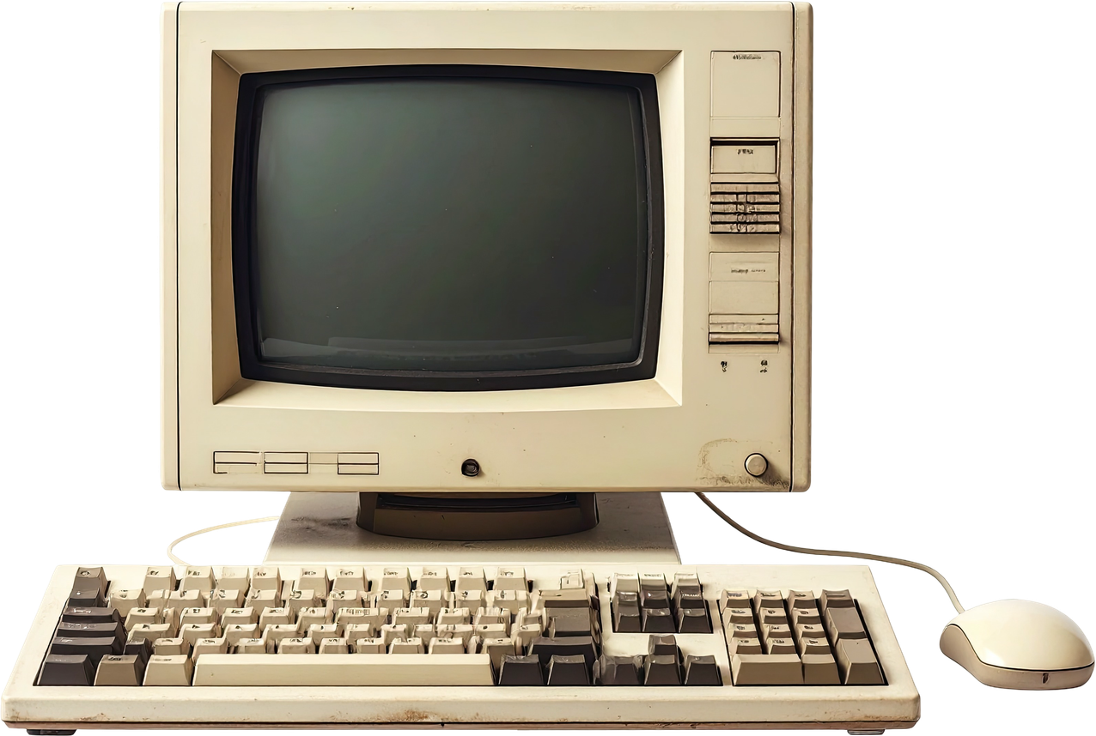
FOURTH GENERATION (1980S)
•Rise of personal computers
•MS-DOS (1981)
•Command-line interface
•Single-user system

Slide 8
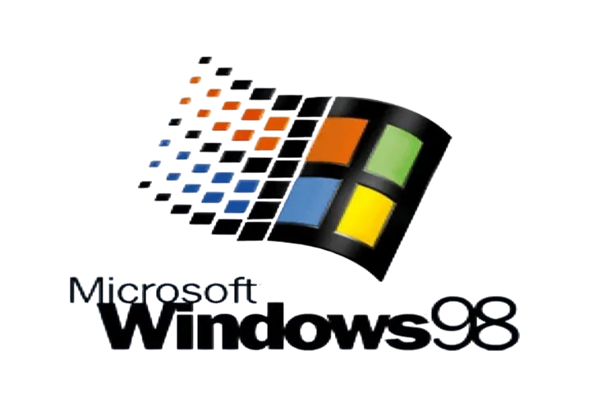
1990S WINDOWS ERA
•Windows 3.x popularized GUI
•Windows 95 major leap
•Start menu introduced
•Windows NT for enterprise

Slide 9

OPEN SOURCE REVOLUTION
•Linux by Linus Torvalds
•Unix-like kernel
•GNU tools integration
•Dominates servers

Slide 10
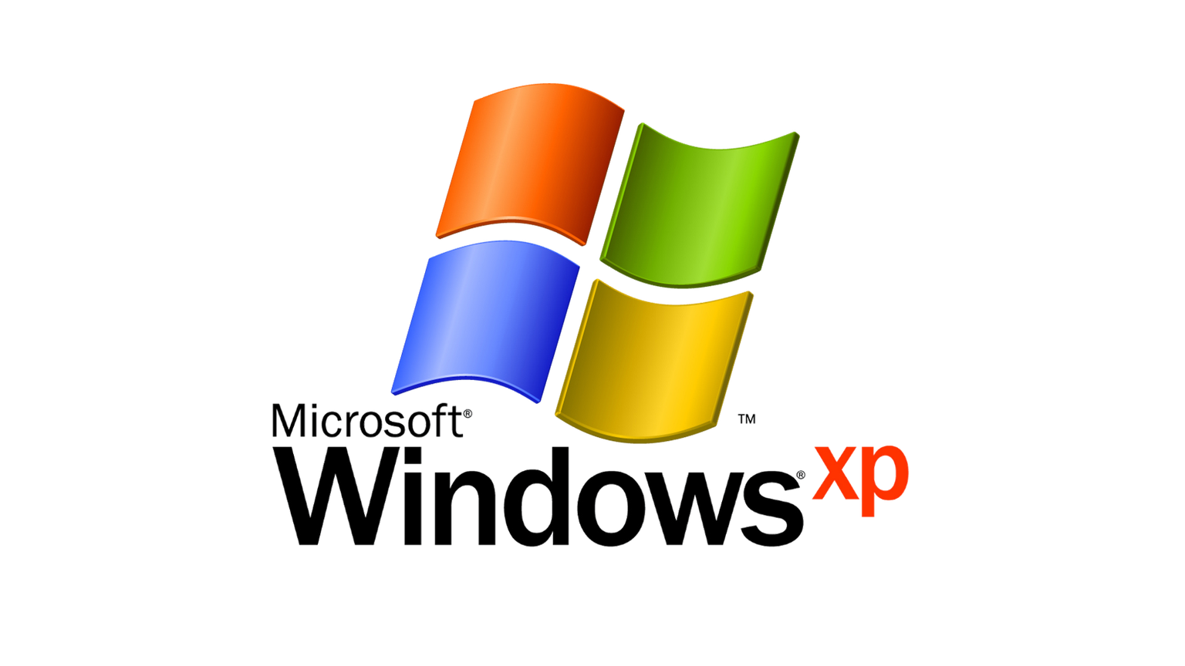
2000S EVOLUTION
•Mac OS X UNIX-based
•Windows XP stability
•Internet & WiFi support
•Multimedia advancements

Slide 11
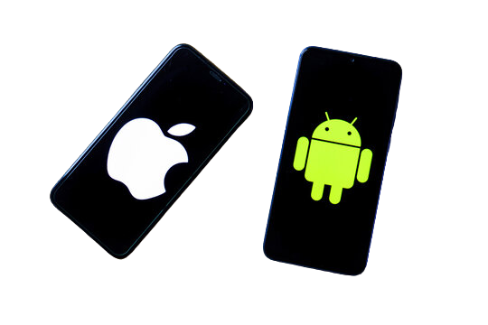
MOBILE REVOLUTION
•iOS (2007)
•Android (2008)
•Touch interfaces
Sensor integration

Slide 12
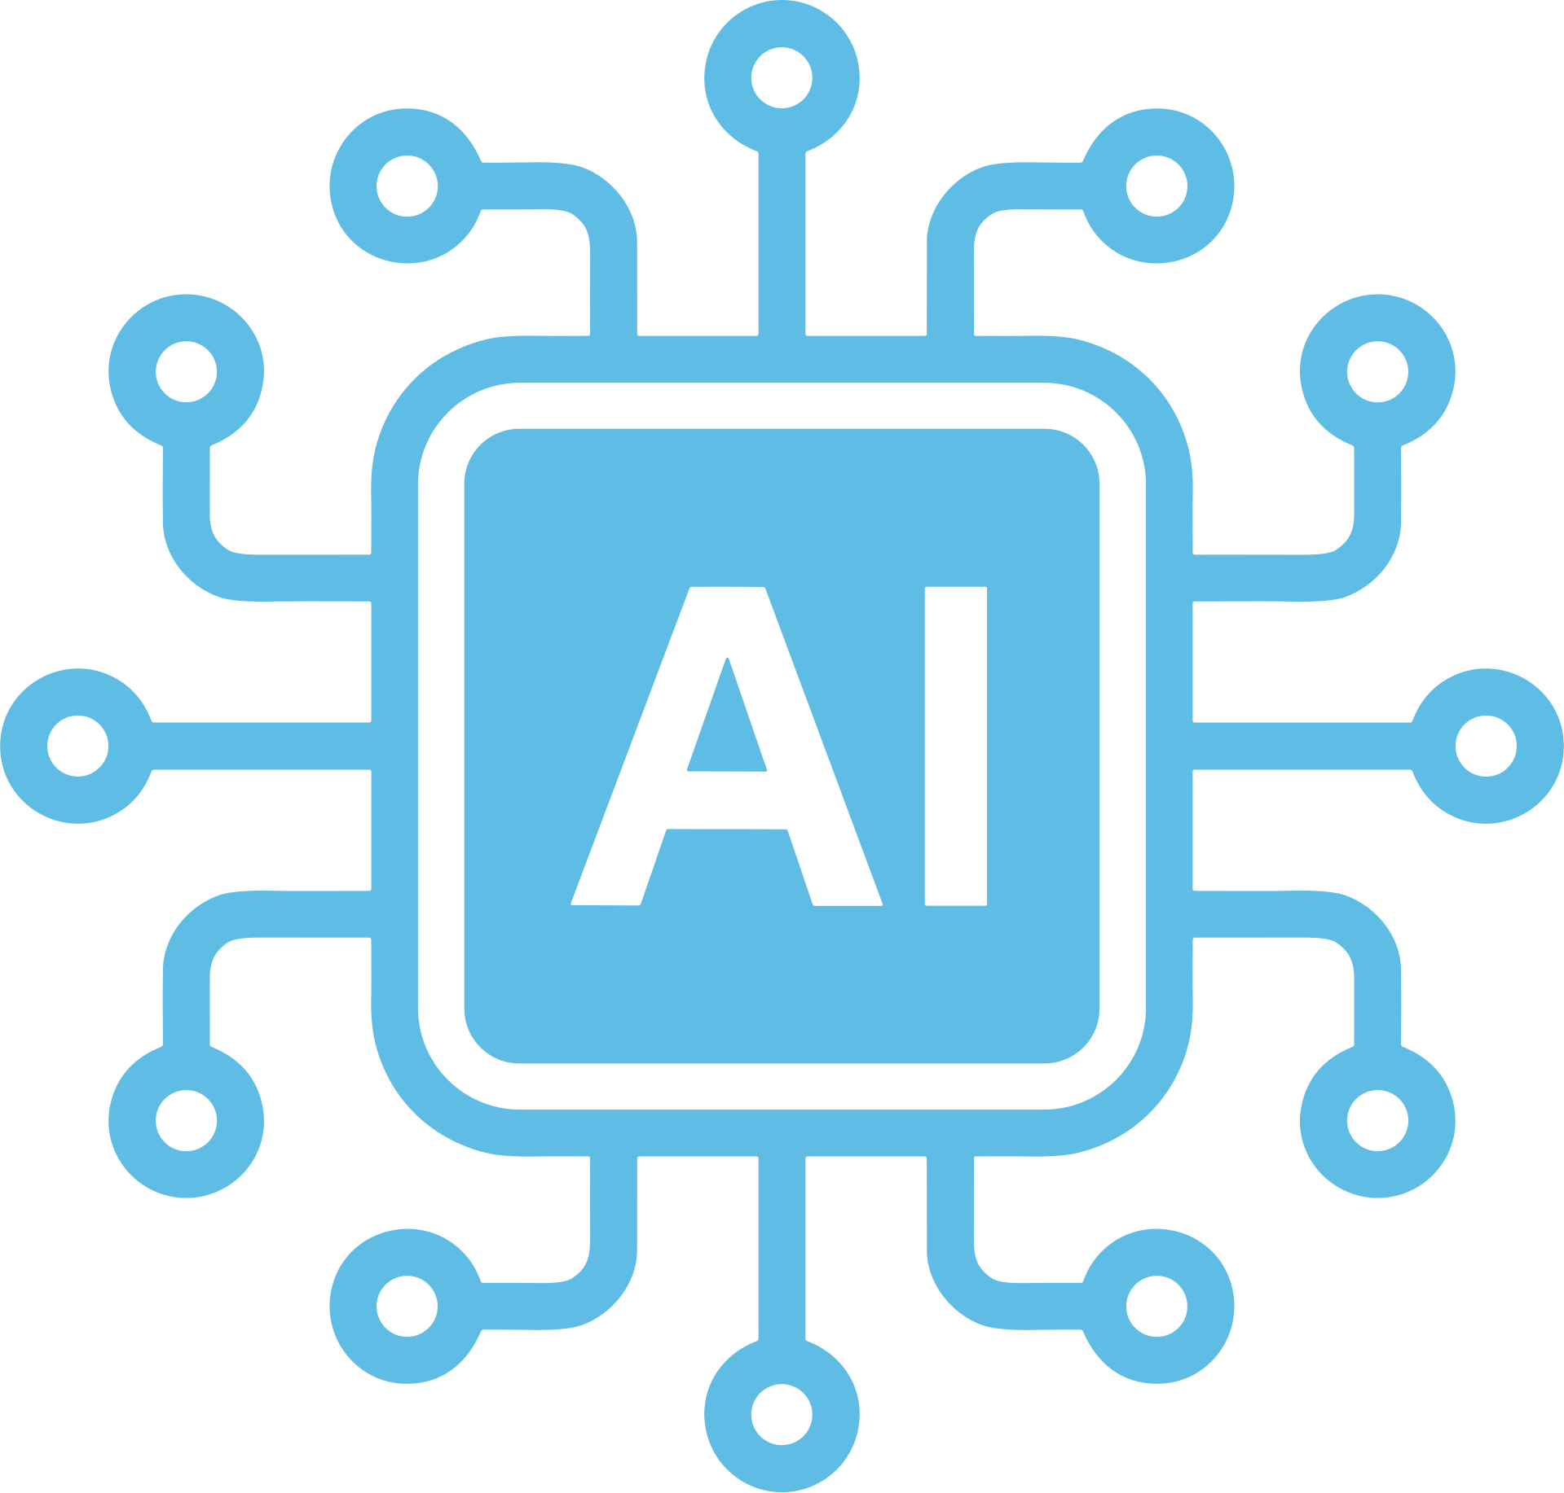
MODERN ERA
•Cloud computing
•ChromeOS browser-based
•Strong security focus
•AI-driven systems
•IoT expansion
•Quantum OS concepts

Slide 13
THANK YOU!

